Slide 1
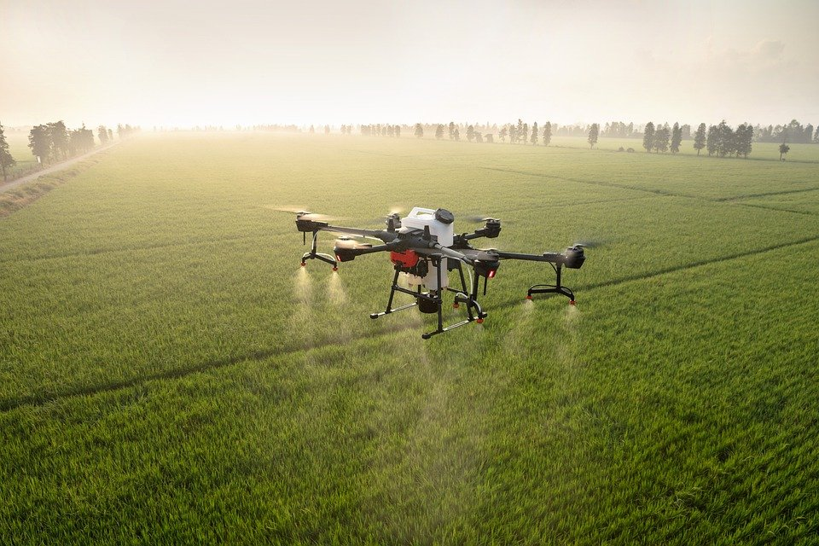

GAAP Proposal: Mexico
Team: Yihang Zhao, Yixuan Yang, Lourdes Siman

Slide 2
Agenda
01
04
Risks & Possible Strategy Plan
Overview of Mexican Market and Environment
02
External Environment
05
Points Moving Forward
03
06
Reference
Competitive Advantages in Mexico

Slide 3
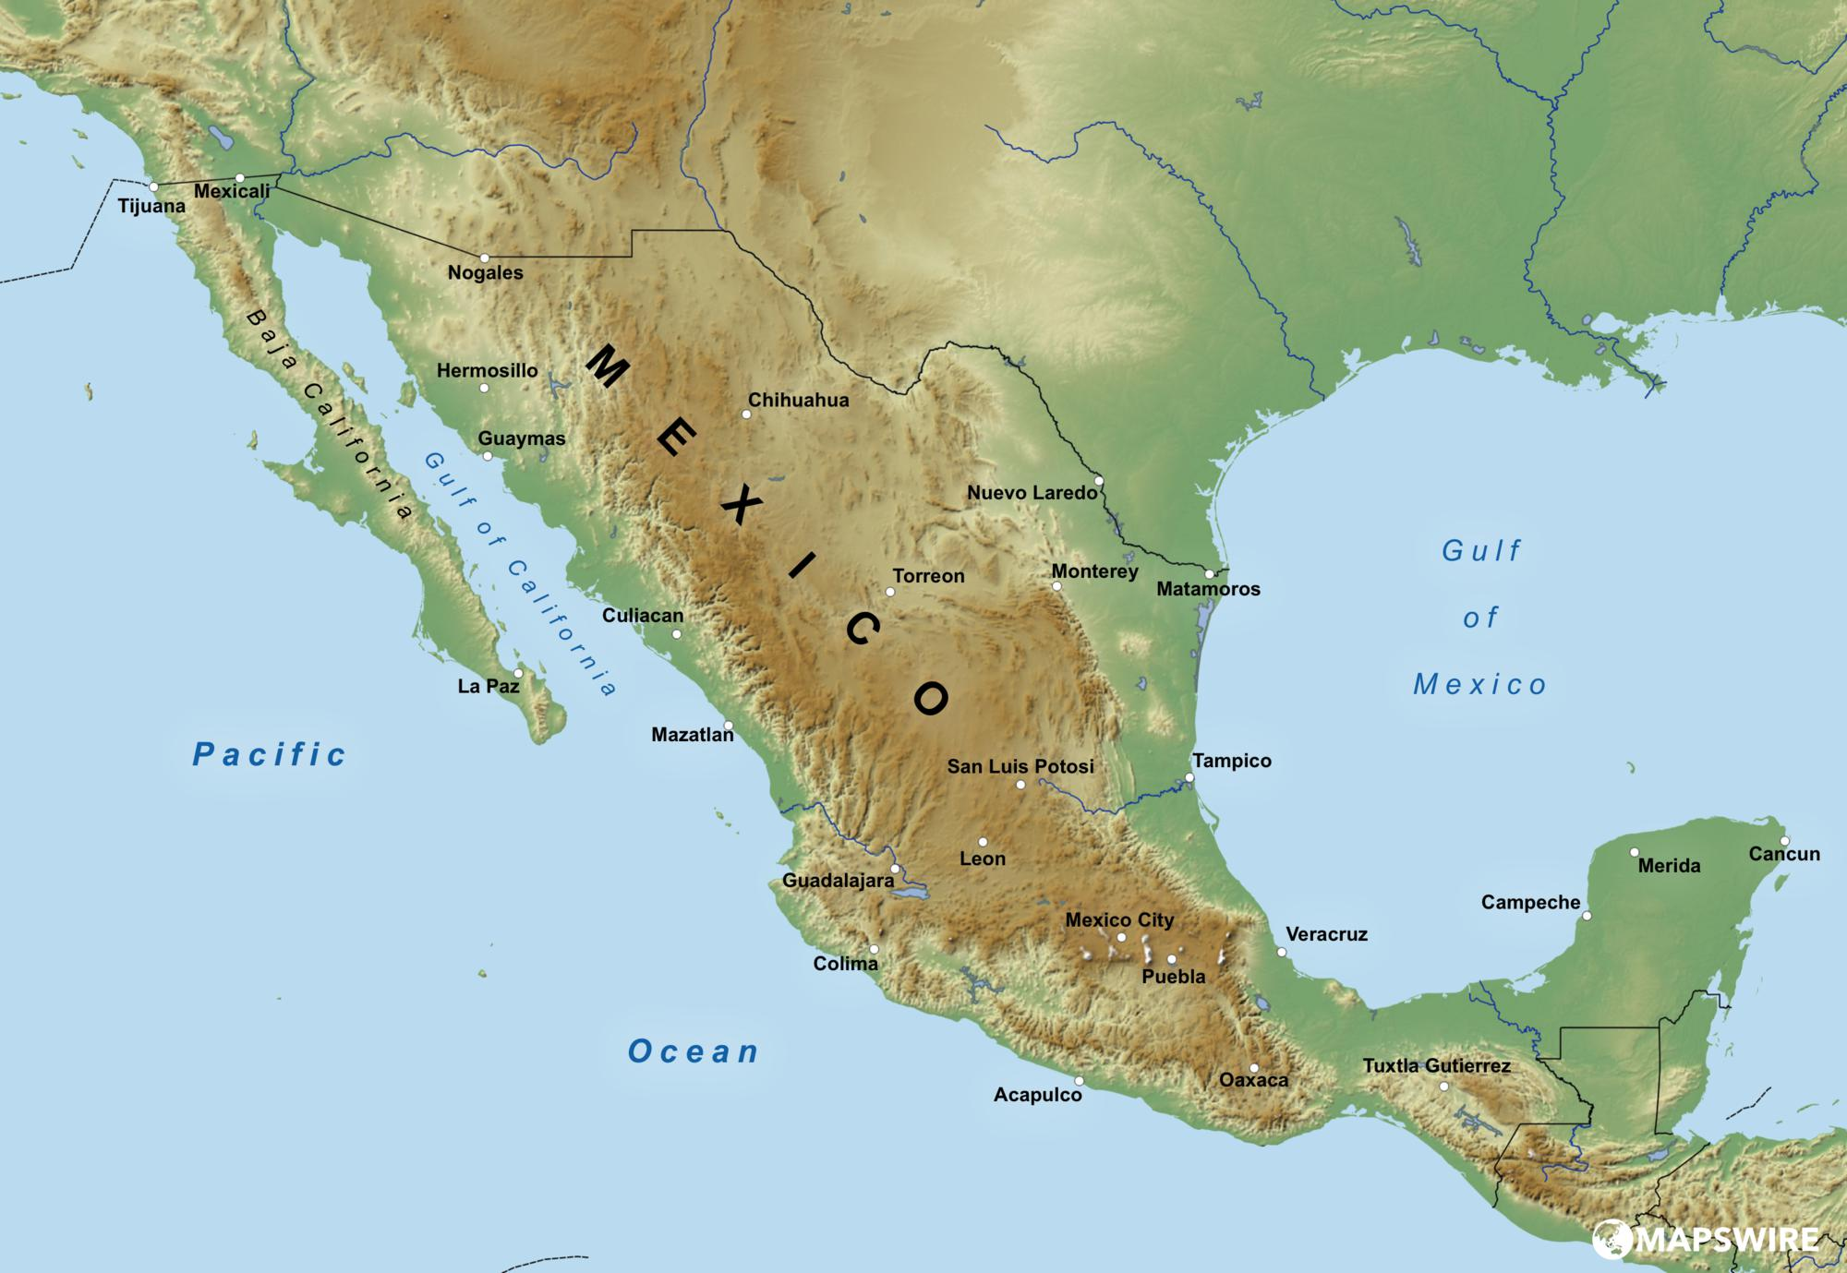
Mexico Overview and Environment

Slide 4
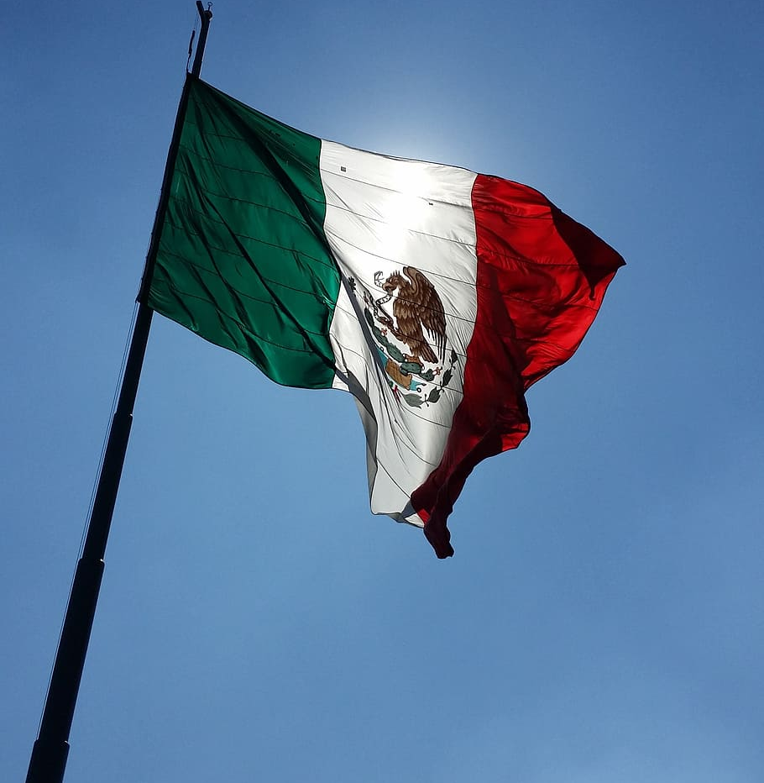
Location: Mexico
Agricultural Land: 31.2 million hectares
Second biggest agri-tech industry in LatAm
Precision Agriculture holds 15% share of agri-tech market
Compound Annual Growth Rate for Precision Agriculture by 2025: 16.8%
Precision Agriculture Market Value: 159 mil
Close to US and part of NAFTA and USMCA
US major trade partner with 76.49% of share for imports and exports

Slide 5
Drone Regulations
Regardless of weight, all unmanned aerial vehicles must be used in daylight, and not in restricted areas for instance: 9.2 km away from Airports.
Weight: <2kg
No need for DGAC authorization
Need insurance to third parties for commercial use
Weight: >2kg-25kg
Need authorization from DGAC for commercial use
Weight: >25kg
Need authorization from DGAC
Terms and conditions set by DGAC
Need pilot’s licence
*note: 1 pound = 0.45 kg (10 pounds is 4.5 kg)

Slide 6
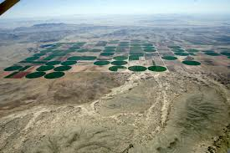
Mexican States of Focus: Chihuahua
Borders with US
4th largest Agricultural Producer
1.37 million acres for agriculture
Crops of Focus: Cotton
70.2% of Mexico’s cotton
Mex 3rd largest cotton producer in LatAm
Drought and increasing prices of water demand precision agriculture
Other important crops: Alfalfa, Oats, Nuts, Green Peppers and Onions

Slide 7
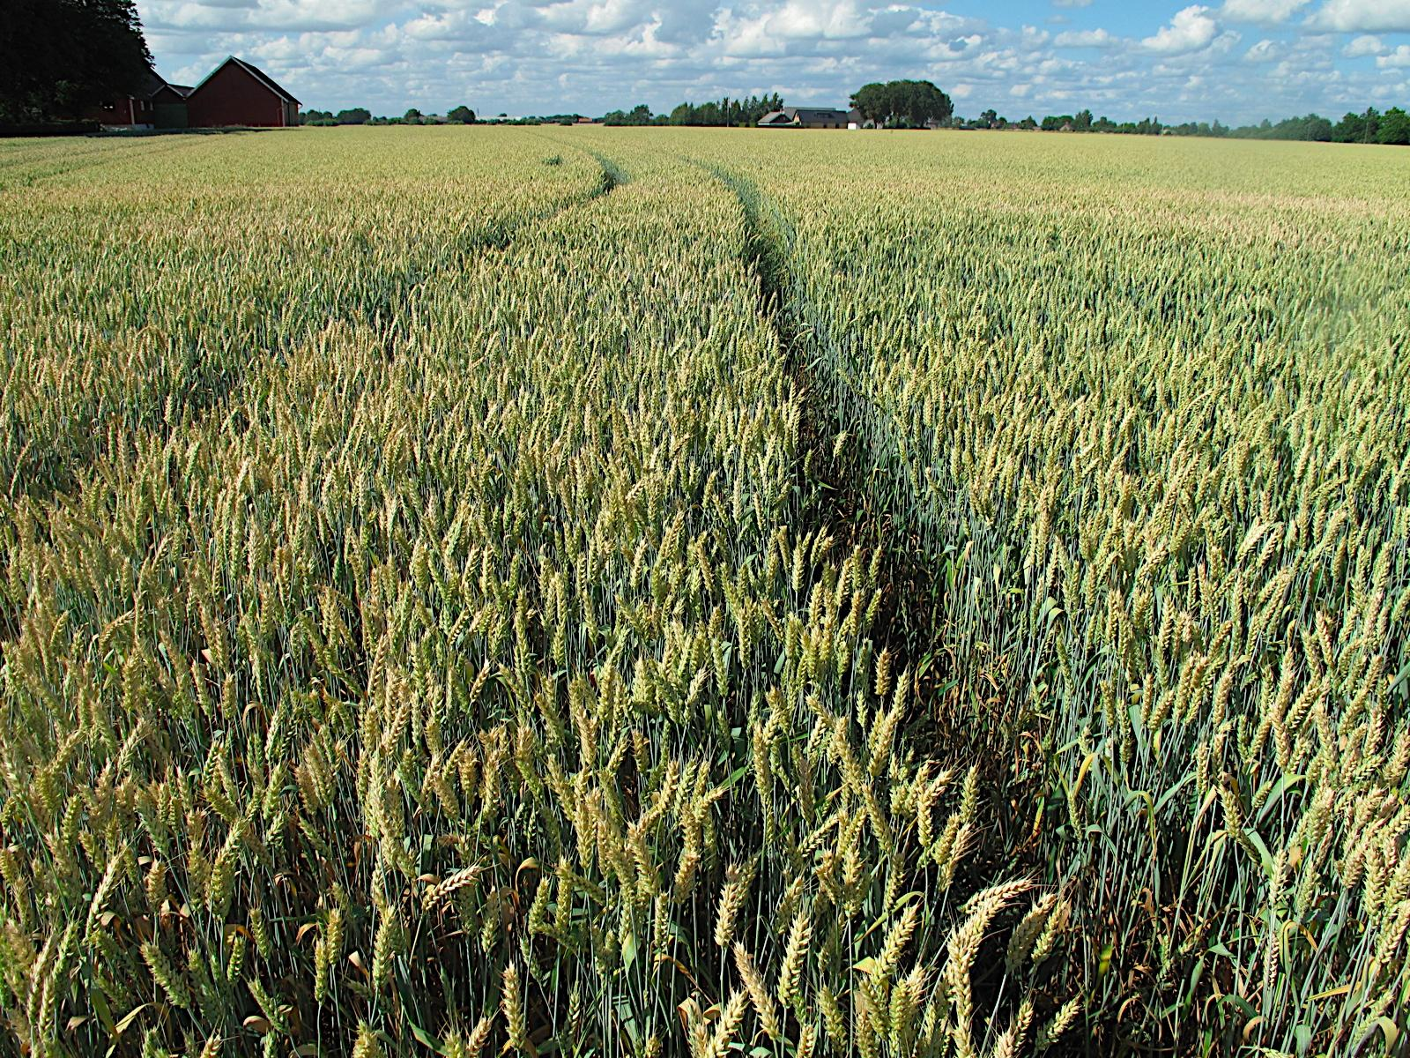
Mexican States of Focus: Sonora
Borders with US
759,476 hectares of Agricultural land
Top crops of interest: Wheat and Corn
Due to climate variability, Sonora has had to invest more in agri-tech
Depends highly on rain levels and could benefit from drones to better-use water resources

Slide 8
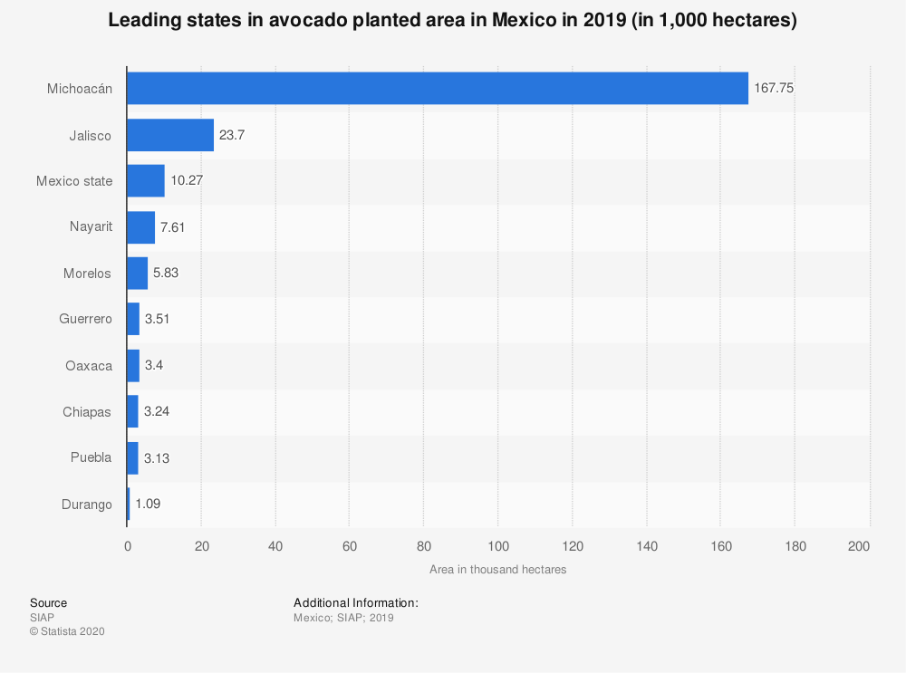
Mexican State of Focus: Michoacan
More than 71% of Mexican Avocados are grown in Michoacan
Mexico is the top producer of Avocado
High value crop
Needs more care, security and attention.

Slide 9
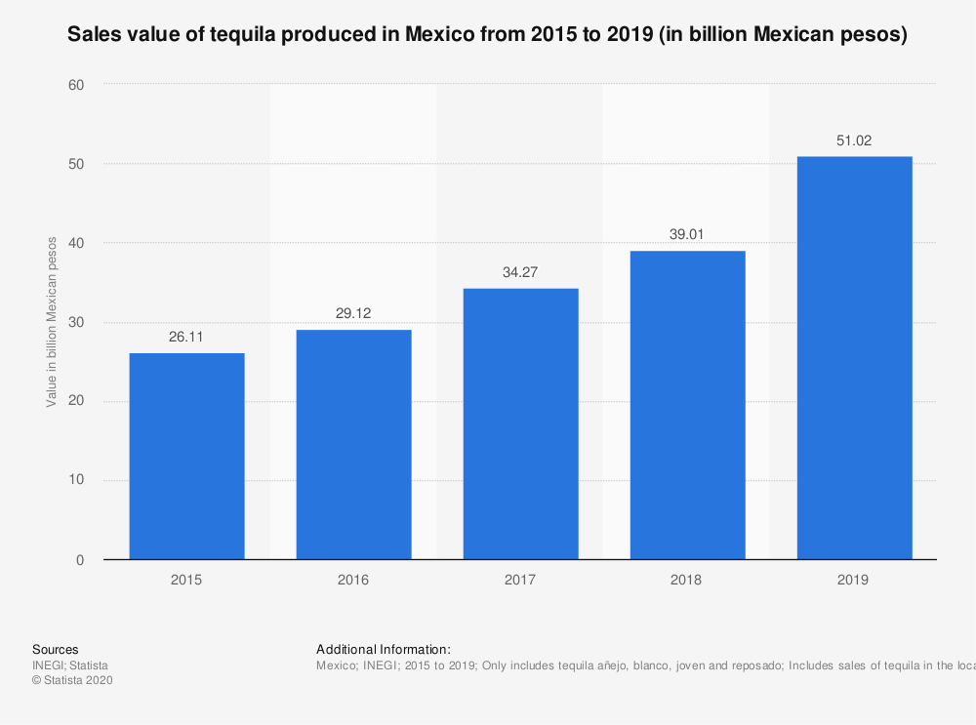
Mexican States of Focus: Jalisco
Top Crops: Corn, Sugarcane and Agave
76.1% of Agave production in Mexico
Agave is used for Tequila
In 2 decades, tequila production has increased by 237%
Losses due to theft: $500,000 in 2017
Opportunity for precision farming

Slide 10
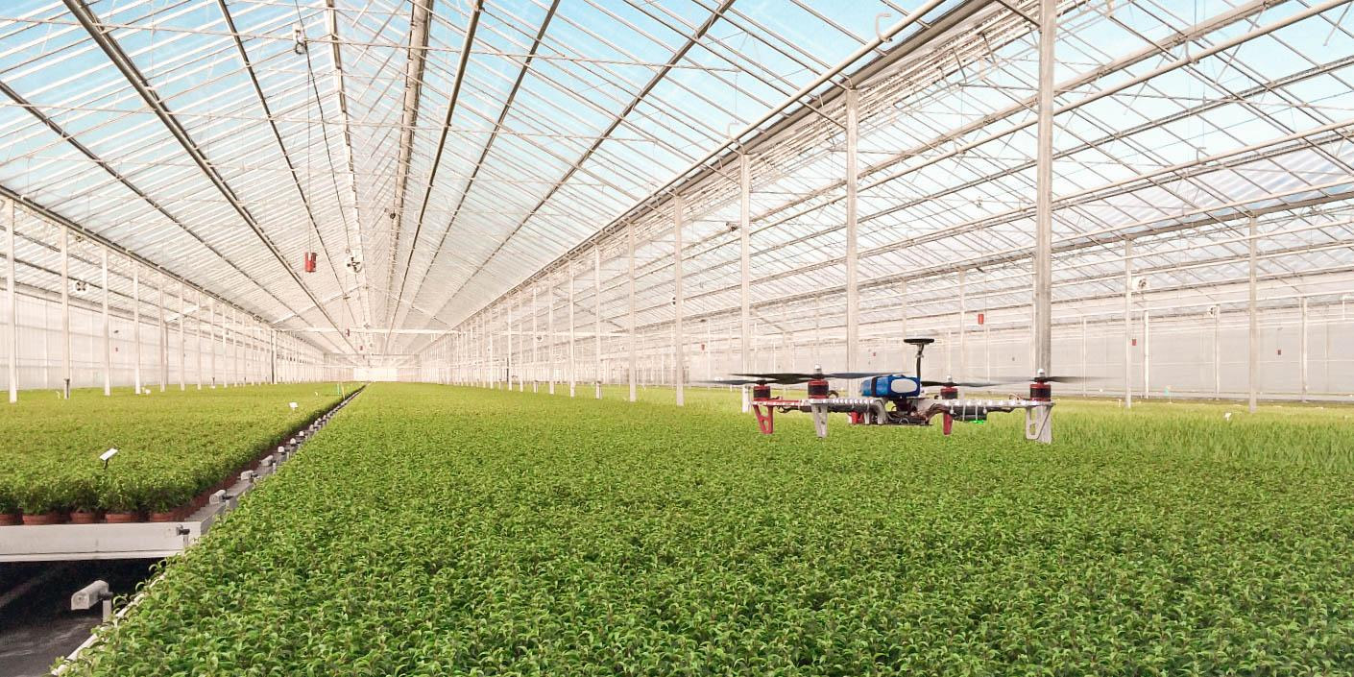
Excellent
External
Environment

Slide 11

Policy Environment
EASE-RK is 43; there is no much limitations on accessing the business
American and Mexico trade and cooperate history and beneficial trade regulations(United States-Mexico -Canada Agreement USMCA)

Slide 12

Economic Environment
Multinationals are already growing their crops in Mexico. Example: Pepsico’s Frito lay grows its potatoes in Mexico.

Slide 13
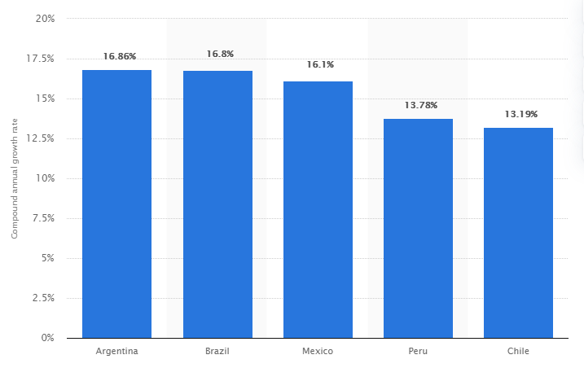
Compound annual growth rate
Mexico
+16.1%
From 2019 to 2025, Mexico was expected to register a relatively high compound annual growth rate (CAGR), amounting to 16.1 percent.
Notes:
https://www-statista-com.proxygw.wrlc.org/statistics/1184401/latin-america-precision-agriculture-cagr-country/

Slide 14

Social Environment
ELEC-PC is 97.2 which means the infrastructure of electricity is complete in the rural area.
Closeness to the US makes it an easier location for shipment and travel.

Slide 15
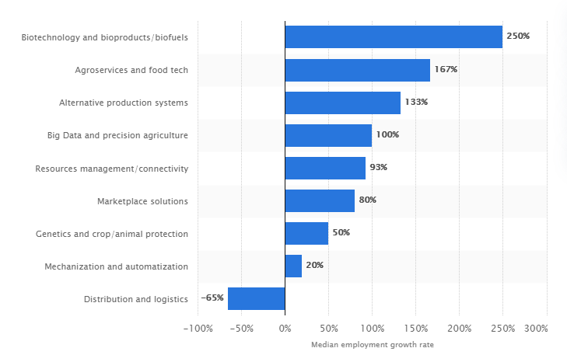
Employment growth rate
100%
Big Data and precision agriculture
Mexico has enough work force in big data and precision agriculture. 100% 2017-2019 & education
Notes:
https://www-statista-com.proxygw.wrlc.org/statistics/1184250/smart-agriculture-mexico-jobs-growth-sector/

Slide 16
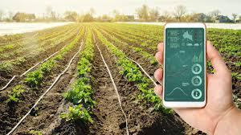
Technological Environment
Mexico is considered a priority market for US agricultural machinery industry. Agricultural equipment exports from the US to mexico in 2019 totaled 1.6 billion USD which is 69% of market share. (ITA)
Notes:
https://www-statista-com.proxygw.wrlc.org/statistics/1114877/mexico-government-investment-telecommunication-infrastructure/

Slide 17
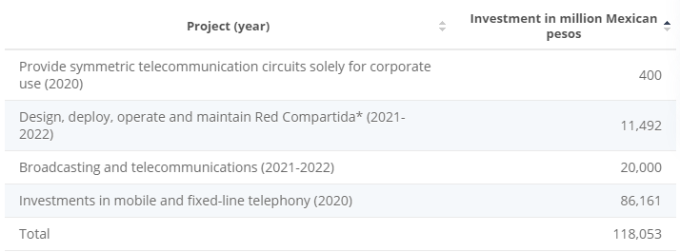
Government Investment
Between 2020 and 2022, the government intended to invest 118.05 billion Mexican pesos in telecommunication infrastructure

Slide 18
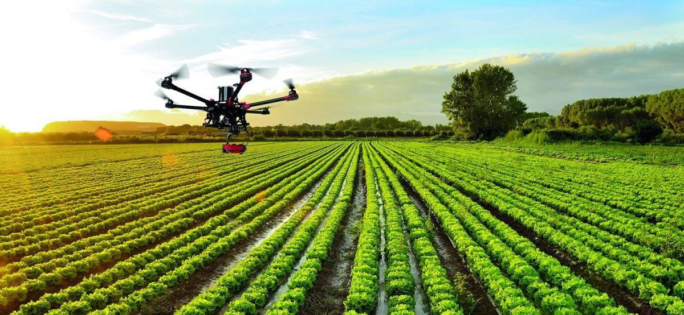
Competitive
Advantage in Mexico

Slide 19
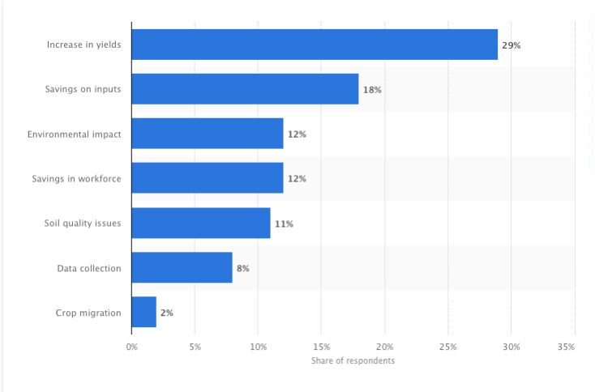
Incentives of using
GAAP is a cutting-edge analytics tech. And increase in yields and Savings on inputs are top 2 incentives which encourage clients in Mexico to adopt agriculture technology

Slide 20

Farmers in Mexico
The low price of GAAP would be affordable for most smallholders and farmers in Mexico
GAAP is easy to control and manipulate which can save users’ training costs

Slide 21
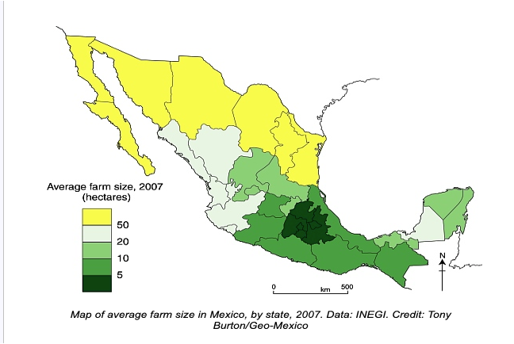
Average Farm Size
According to the graph, the average farm size varies dramatically across the Mexico landscape. By using precision technology, the increase in yields remain proportionate between large and small plots of land
Notes:
Graph -- https://geo-mexico.com/?p=11019#:~:text=It%20is%20very%20clear%20that,that%20are%20below%205%20hectares.
Proportionate -- http://www.emtoscipublisher.com/index.php/ijh/article/html/3086/

Slide 22

Competitive Price
Since we need to be fast, we could set up our prices to be lower than our competitors, such as Pix4D.
Notes:
Pricing of Pix4D: https://www.pix4d.com/pricing/pix4dfields

Slide 23
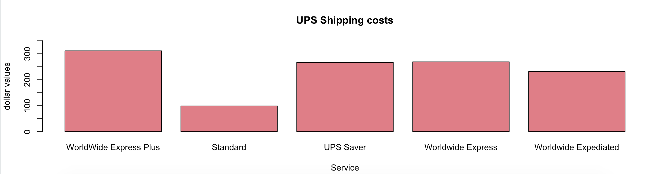

Competitive Shipping Costs
Because Mexico is relatively close to United States, standard shipping costs would fluctuate between $80 - $150. This shipping cost is very economic comparing to other countries such as Australia and India.

Slide 24
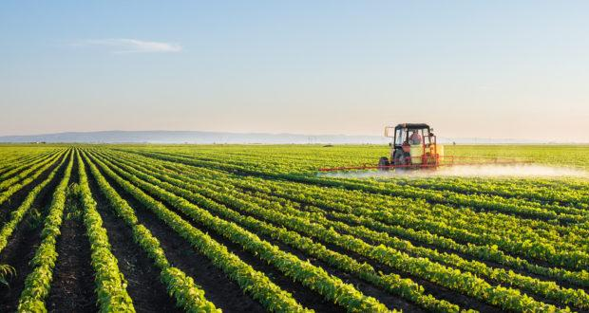
Risks & Possible Strategy Plan

Slide 25

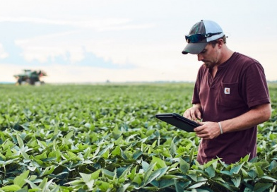
Risks
Limited R&D Investment
Tech innovation, product upgrading slowly
High Inflation Rate 4% & Repatriation Tax 35%
Profit loss for investors
Official Exchange Rate 13.3
The devaluation of Mexican peso will impair the Mexican purchasing power even though the cost of investment will decrease for the company

Slide 26
Possible Strategy Plan
Price Strategy
Promotion
Different pricing for different product categories
Google ads
SEO(search engine optimization)
Customer Service
Sustainable Partnership
Connect customers with third-party(Training, Maintenance, Data analytics, Consulting)
Data Security
Build strategic partnership with drone company; third-party consulting firms, etc

Slide 27

Conclusion
Internal Market
External Environment
Competitive Advantages
Strategy Plan
Your Logo

Slide 28

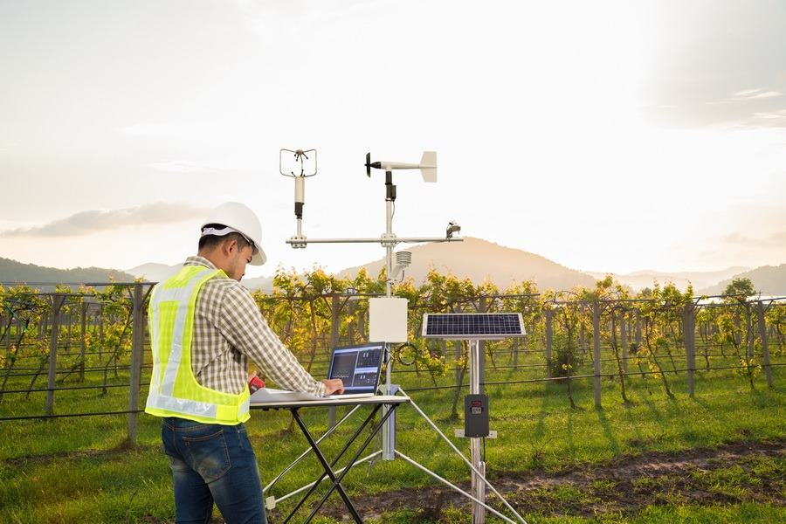
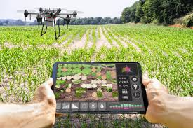
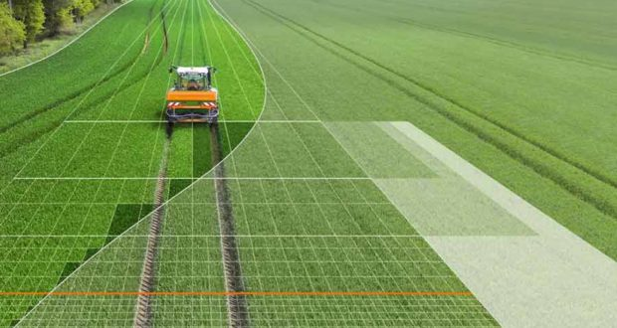
Thanks!
Any Questions?

Slide 29
Reference
1.37-https://www-statista-com.proxygw.wrlc.org/statistics/1123753/latin-america-precision-agriculture-market-value/
16-https://www-statista-com.proxygw.wrlc.org/statistics/1184401/latin-america-precision-agriculture-cagr-country/
(1)https://www-statista-com.proxygw.wrlc.org/statistics/1184343/mexico-incentives-agricultural-technology-adoption/
100%-https://www-statista-com.proxygw.wrlc.org/statistics/1184250/smart-agriculture-mexico-jobs-growth-sector/
118.05-https://www-statista-com.proxygw.wrlc.org/statistics/1114877/mexico-government-investment-telecommunication-infrastructure/
119,715,000 -https://search-proquest-com.proxygw.wrlc.org/docview/1927472095?accountid=11243&pq-origsite=primo
31.2 - https://search-proquest-com.proxygw.wrlc.org/docview/1927472095?accountid=11243&pq-origsite=primo
smallholder-http://www.emtoscipublisher.com/index.php/ijh/article/html/3086/
Competitors in Mexico-https://www.pix4d.com/industry/agriculture
Mexico production by state: https://agroproductores.com/principales-estados-agricolas-de-mexico/
International Trade Administration- Mexico Country Commercial Guide: https://www.trade.gov/knowledge-product/mexico-c-agribusiness

Slide 30
Reference
https://www-statista-com.proxygw.wrlc.org/statistics/729533/forecasted-market-size-of-drones-in-smart-agriculture-worldwide/
https://www-statista-com.proxygw.wrlc.org/statistics/1184391/latin-america-precision-agriculture-market-country/
https://www-statista-com.proxygw.wrlc.org/statistics/1184401/latin-america-precision-agriculture-cagr-country/
https://www-statista-com.proxygw.wrlc.org/statistics/1177589/mexico-challenges-agricultural-technology-businesses/
https://www-statista-com.proxygw.wrlc.org/statistics/1184343/mexico-incentives-agricultural-technology-adoption/
https://www.sct.gob.mx/uploads/media/Comunicado_190_2015.pdf
https://www-statista-com.proxygw.wrlc.org/statistics/311696/mexico-s-tequila-production/
http://www.chihuahua.gob.mx/contenidos/ocupa-chihuahua-primeros-lugares-en-produccion-agricola-y-pecuaria#:~:text=En%202018%20produjo%2047%20mil,trigo%20forrajero%20verde%20y%20pistache.
https://www-statista-com.proxygw.wrlc.org/statistics/591489/mexico-planted-avocado-area-by-st
https://wits.worldbank.org/countrysnapshot/en/mex
Flores, D.; Vazquez-Nicolas, J.M.; Rogelio Lozano, I.G.; Hernandez Toral, J.L. Automated Agave Detection and Counting Using a Convolutional Neural Network and Unmanned Aerial Systems. Drones 2021,5,4. https://doi.org/ 10.3390/drones5010004
https://iieg.gob.mx/ns/wp-content/uploads/2020/05/Estudio-de-exportaciones-de-tequila-mayo-2020.pdf
http://sagarhpa.sonora.gob.mx/portal_sagarhpa/images/archivos/PMP/PMPAGRICOLA20162021.pdf

